Slide 1

OffensEval 2020: Multilingual Offensive Language Identification in Social Media
Team 5
Sneha Kumaran, Xiaoqing Liu, Phani Preetam Kommineni, and Shristi Kota
Notes:
Sneha

Slide 2
01
Background
Context and reasons
02
Introduction
Dataset and goals
03
Method
Data Preprocessing
Model selection, evaluation for three subtasks
04
Results
Results for 2019 and 2020 testing data
05
Summary
Conclusion of the project
Notes:
Sneha

Slide 3
Background
Offensive language is pervasive in social media
Lots of users tend to be influenced by the anonymity of computer-mediated communications
Many online platforms, social media communities are attempting to find ways to detect and strategize to stop profanity/hate/and abusive behaviors and languages
Many models and systems are being created to identify hate speech by users generated content:
Posts
Comments
Microblogs
Notes:
Sneha

Slide 4
Introduction - Tasks
Task 1 - Subtask A: Offensive Language Detection
(NOT) - Not Offensive - This tweet does not contain any offense/profanity
(OFF) - Offensive - This tweet contains offensive language or target offense
Task 2 - Subtask B: Categorization of Offensive Language
(TIN) - Targeted Insult and Threats - This tweet contains an insult or threat to an individual, group, or others
(UNT) - Untargeted - This tweet contains a non-targeted profanity/swearing
Task 3 - Offensive Language Target Identification
(IND) - Individual - Offensive tweet targeted to an individual: famous, named or unnamed person
(GRP) - Group - Offensive tweet targeted to a group of people: race, sexuality, religious belief, and political
(OTH) - Others - Offensive tweet targeted to none of the categories above: event, situation, organization
Notes:
Sneha

Slide 5
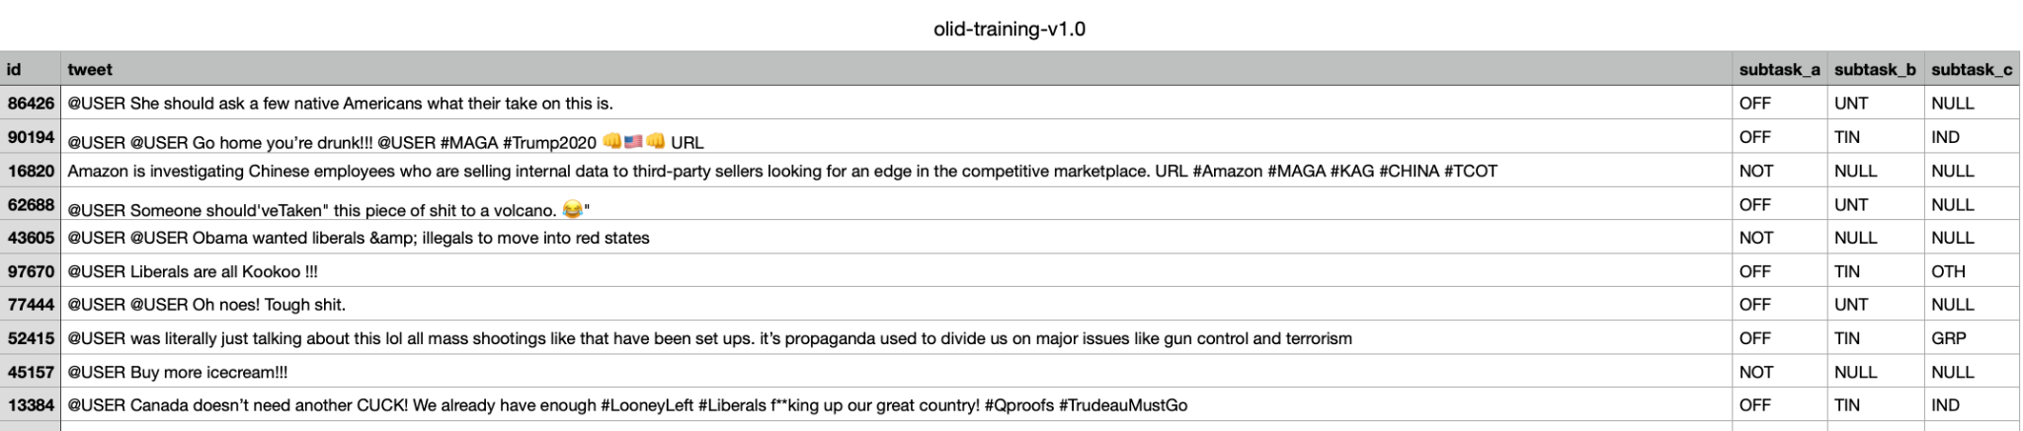
Datasets - SemEval 2019 - OLID Training
14,200 annotated English Tweets olid-training-v1.0.tsv
Used in all subtasks
Notes:
Sneha

Slide 6
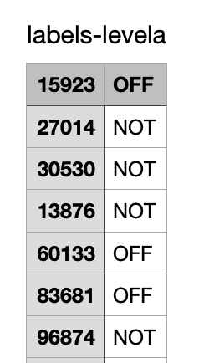
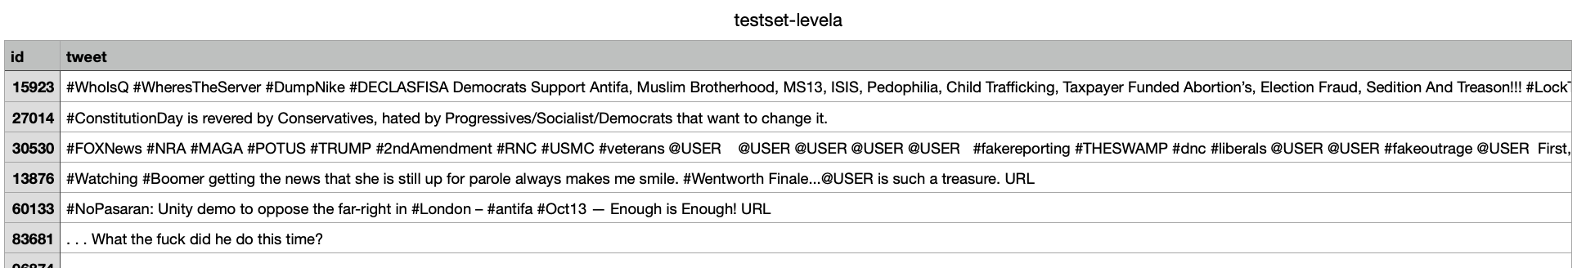
Subtask A OLID 2019 Datasets
labels-levela.csv:
id, label
Gold labels
Layer A
testset-levela.tsv:
id, tweet
Test set
Notes:
Sneha

Slide 7
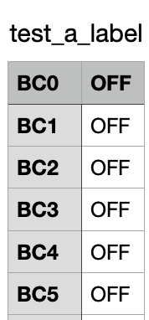
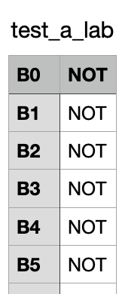
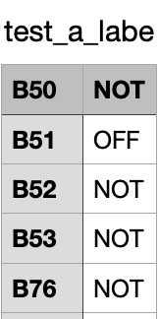
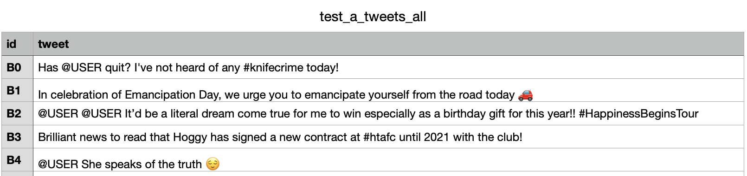
Subtask A SOLID 2020 Testsets
Testset:
Test_a_labels.csv & test_a_tweets.tsv
3,887 tweets
Annotations
Extended testset:
Test_a_tweets_all.tsv &Test_a_labels_easy.csv &test_a_labels_easy.csv
5,995 tweets
Annotations
Table 1. All
test_a_labels_all.csv
Table 2. Easy
test_a_labels_easy.csv
Table 3. Hard
test_a_labels_hard.csv
Notes:
Xiaoqing

Slide 8
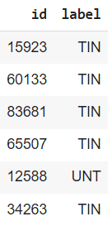
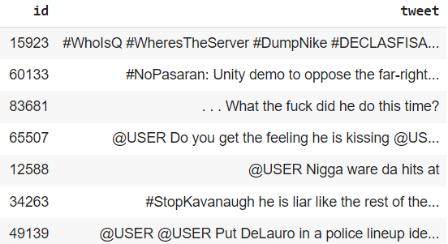
Subtask B OLID 2019 Datasets
labels-levelb.csv:
id, label
Gold labels
Layer b
testset-levelb.tsv:
id, tweet
Test set

Slide 9
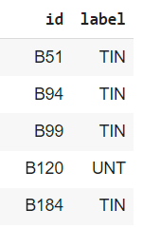
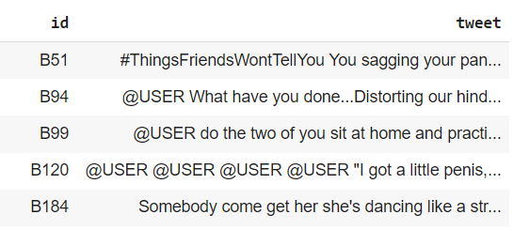
Subtask B SOLID 2020 Datasets
test_b_labels_all.csv:
id, label
Easy (did not use)
Hard (did not use)
All (Used)
test_b_tweets_all.tsv:
id, tweet
Test set

Slide 10
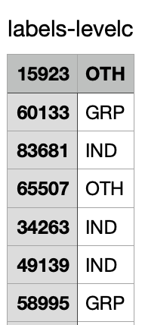
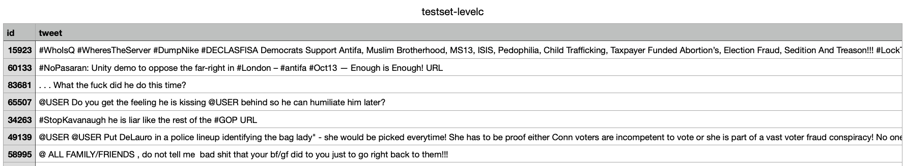
Subtask C OLID 2019 Datasets
labels-levelc.csv:
id, label
Gold labels
Layer c
testset-levelc.tsv:
id, tweet
Annotations
Test set

Slide 11
Subtask C SOLID 2020 Datasets
test_c_labels.csv:
id, label
Easy (did not use)
Hard (did not use)
All (Used)
test_c_tweets_all.tsv:
id, tweet
Annotations
Test set

Slide 12
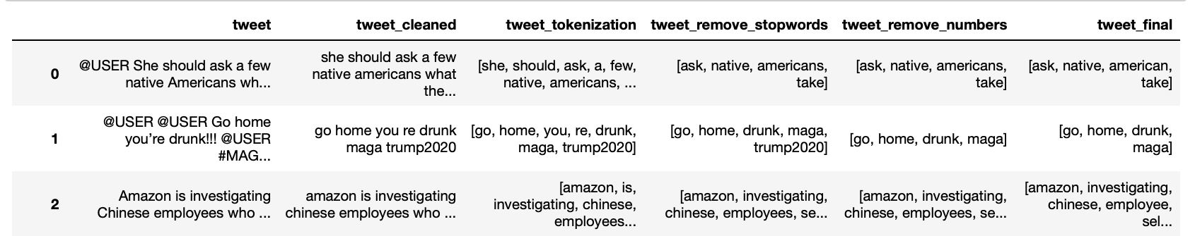
Method - Data Preprocessing (OLID)
Remove punctuations, redundant characters, emojis.
Remove stopwords (nltk)
Lemmatize (nltk)
Tokenize (nltk)
Remove numbers
Notes:
Xiaoqing

Slide 13
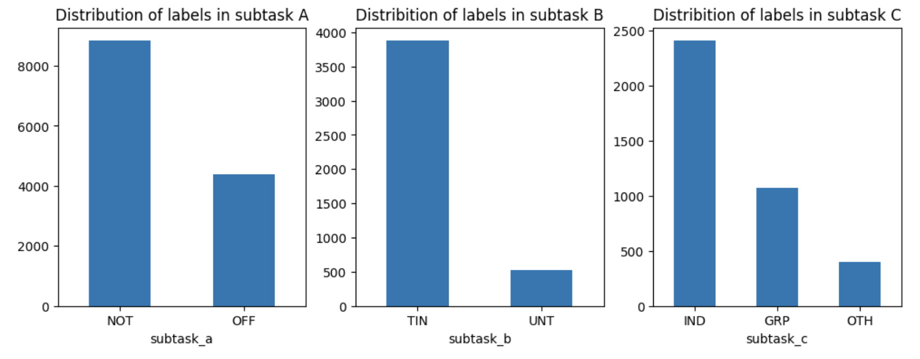
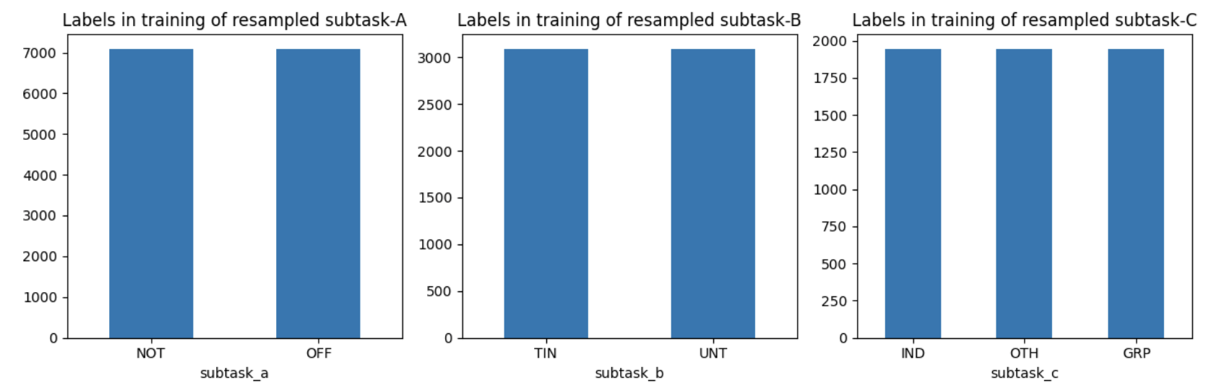
Method - Data Preprocessing
Imbalanced by labels
Randomly split
80% Training
Over sampling
20% Testing
Notes:
Xiaoqing

Slide 14
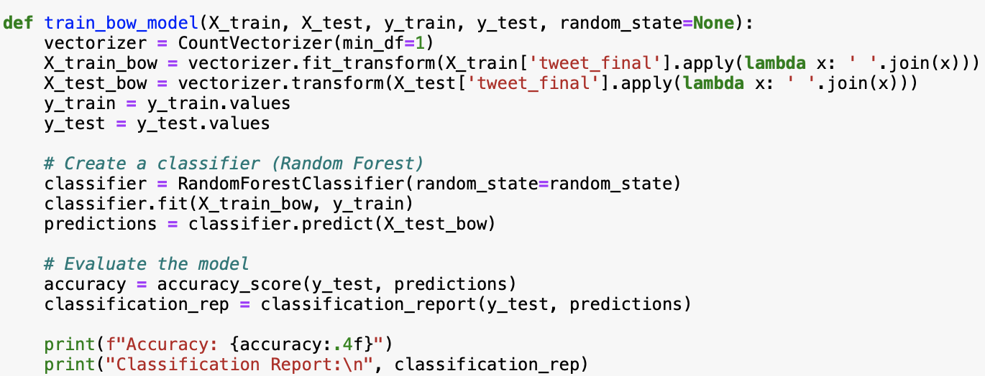
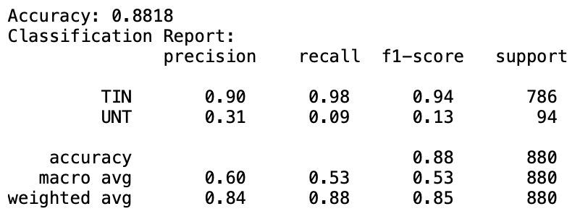
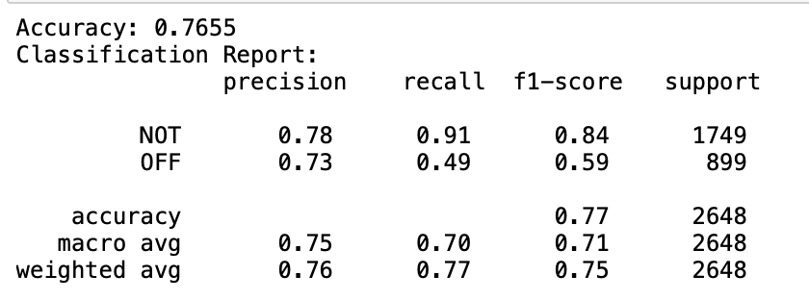
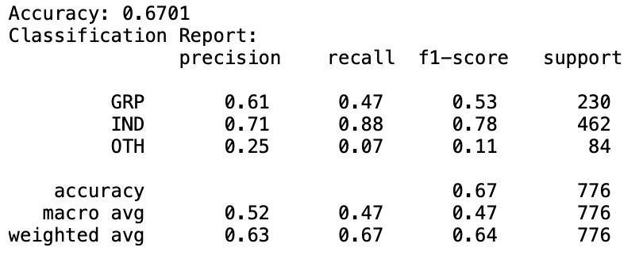
Method - Baseline: Bag-of-Words model
Random Forest
Subtask B:
Subtask A:
Subtask C:
Notes:
Xiaoqing - The purpose of creating a baseline BoW model is to establish a simple and interpretable model that can serve as a starting point for comparison with more sophisticated models

Slide 15
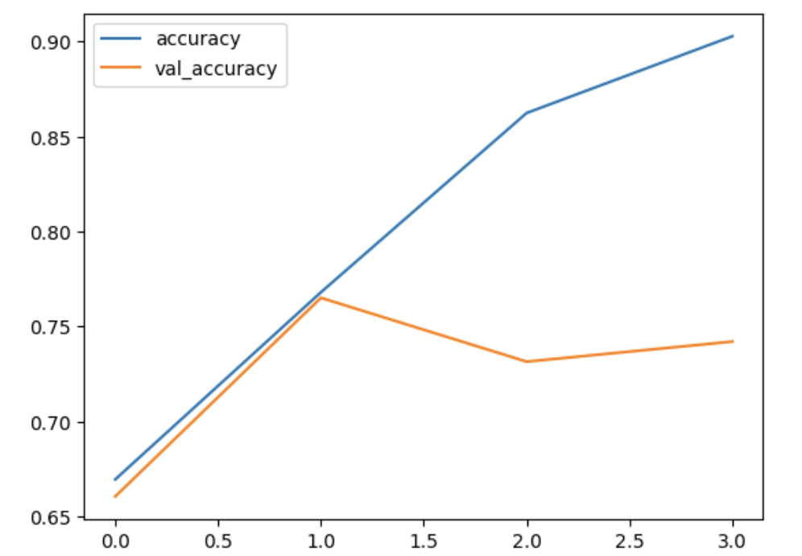
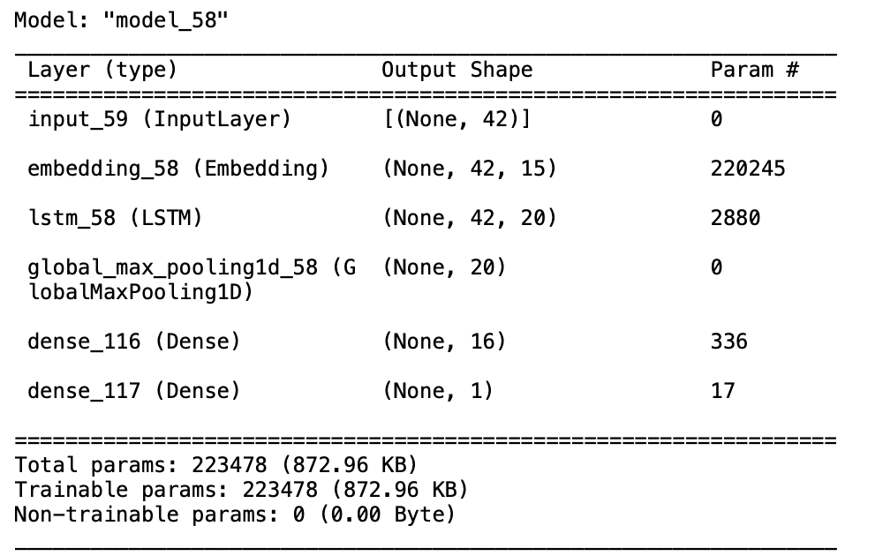
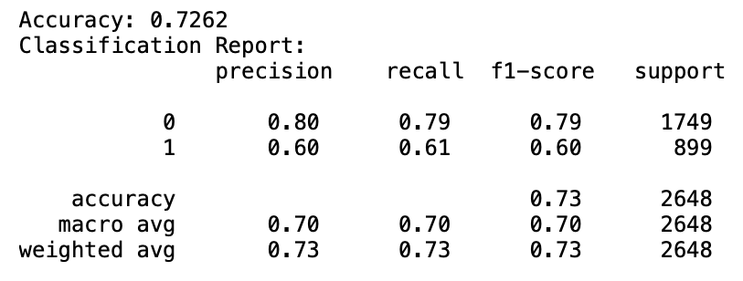
Method - LSTM for subtask A
Training accuracy VS Validation accuracy
Model Summary
evaluation metrics
Not
OFF
Notes:
Xiaoqing

Slide 16
Results - Predict Subtask A Test Data with LSTM
Evaluation metrics for OFF
Dataset | precision | recall | f1-score
olid testset a | 0.62 | 0.55 | 0.59
solid testset a | 0.77 | 0.93 | 0.84
solid extended easy | 0.92 | 0.99 | 0.95
solid extended hard | 0.83 | 0.91 | 0.87
Notes:
Xiaoqing

Slide 17
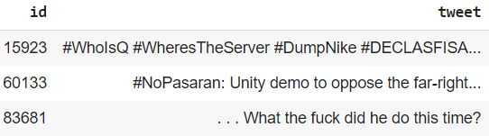
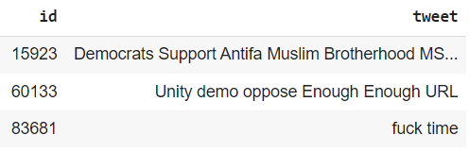
Subtask B - Method - Data Preprocessing
Hashtags and Mentions Removal
Emoji Removal
Number Removal
Tokenization and Alphanumeric Filtering
Stopwords Removal and Lemmatization
Application to Datasets(olid_data, testset_data)
Test Data before preprocessing
Test Data after preprocessing

Slide 18
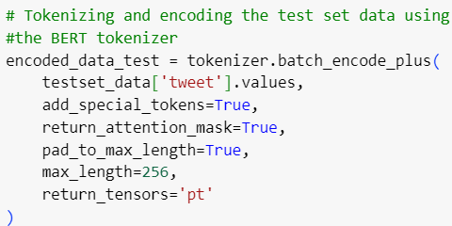
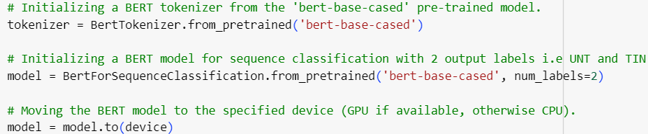
Subtask B - Method - BERT Model Configuration
BERT Model Initialization
Device Configuration
Label Mapping
Data Cleaning
Data Tokenization and Encoding
Test Set Tokenization and Encoding

Slide 19
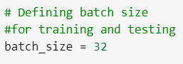
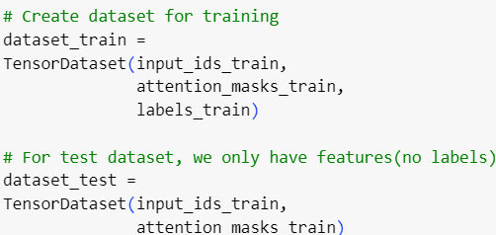
Subtask B - Method -Dataset Creation, Data-loader Setup
PyTorch Datasets Creation
Batch Size Definition(set to 32)
Dataloader Creation

Slide 20
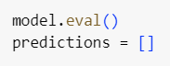
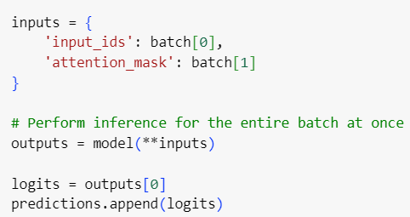
Subtask B - Method - Model Evaluation and prediction
Model Evaluation and Prediction
Batch Processing Efficiency
TensorFlow Inference Optimization
Results Aggregation
Prediction Concatenation
GPU Utilization
Inference Speed Enhancement

Slide 21
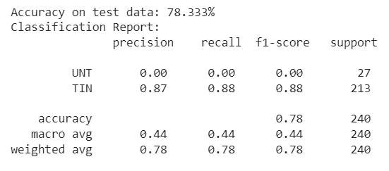
Results - Subtask B - OLID Data
Test Accuracy : 78.333%
Precision : 0.87
Recall : 0.88
F1 Score : 0.88

Slide 22
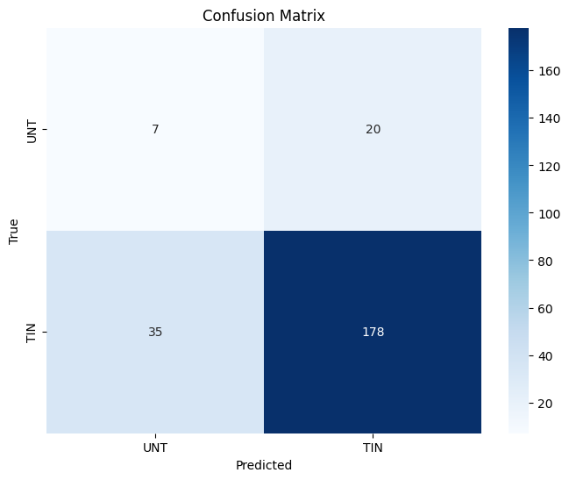
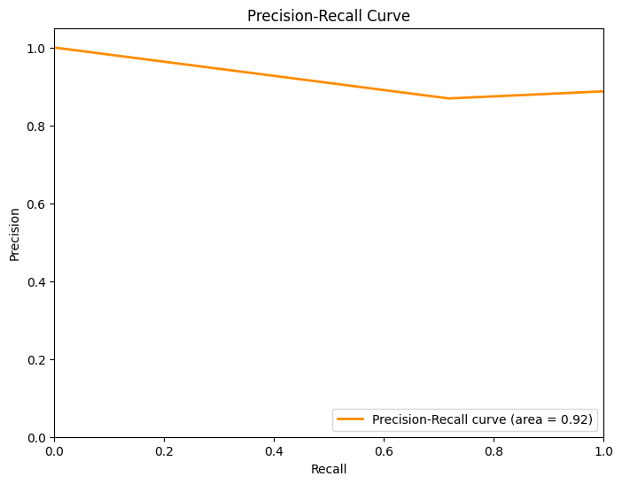
Results - Subtask B - OLID Data

Slide 23
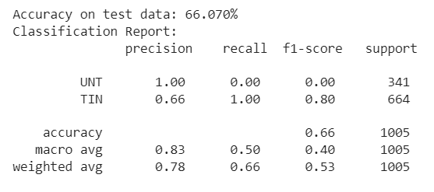
Results - Subtask B - SOLID Data
Test Accuracy : 66.070%
Precision : 0.83
Recall : 0.50
F1 Score : 0.80

Slide 24
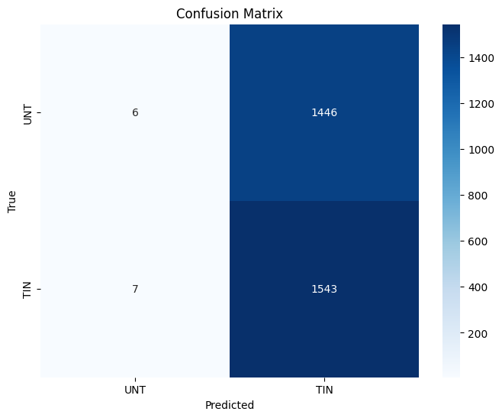
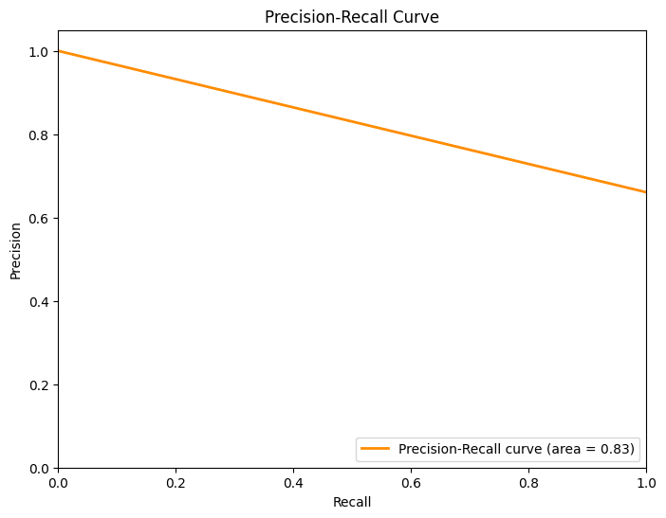
Results - Subtask B - SOLID Data

Slide 25
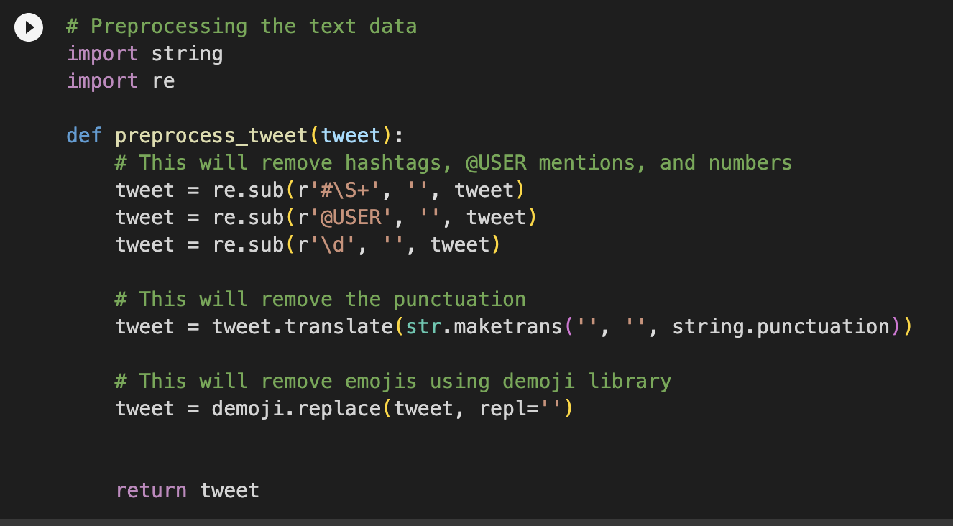
Method - Subtask C (2019-2020)
Support Vector Machine Linear Model
Imported and loaded the 3 data (labels-levelc, testset-levelsc, olid-training-v1.0)
Filled in the null values
Preprocess the tweets by using the re package into olid and testset data
hashtags (re.sub(r'#\S+'))
@USER (re.sub(r’@USER’))
numbers(re.sub(r’\d’))
Punctuation (str.maketrans(‘ ’, ’ ’,string.;punctuation))
Emojis (demoji.replace)
Apply TF-IDF vectorization -> vectorize the tweets and remove stop words
Notes:
Sneha

Slide 26
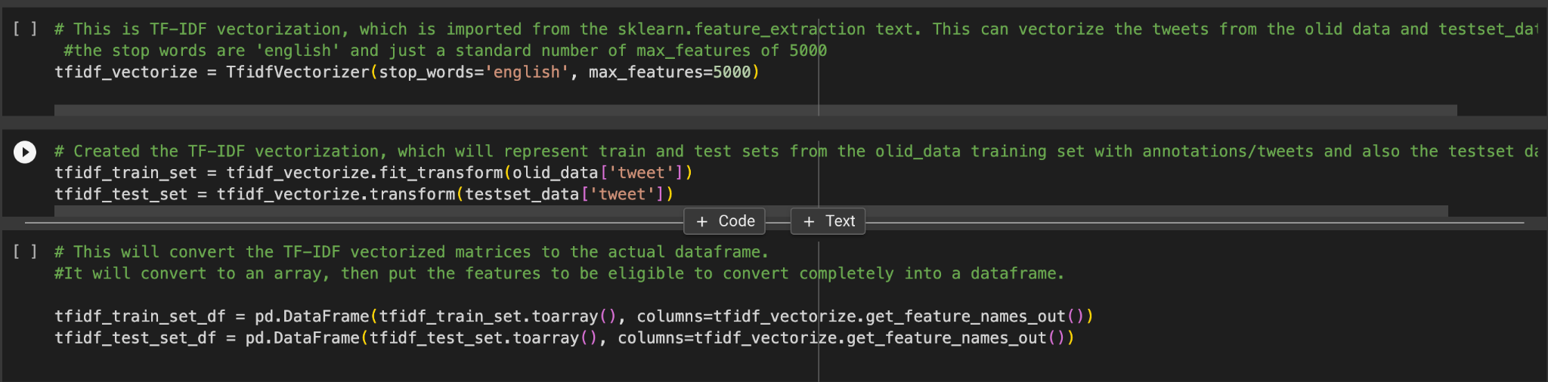
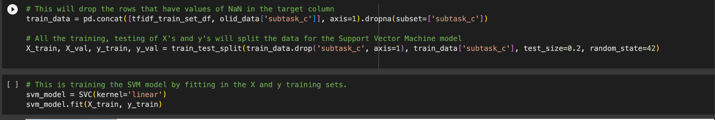
Notes:
Sneha

Slide 27
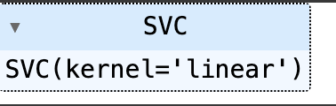
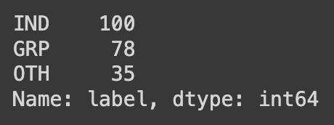
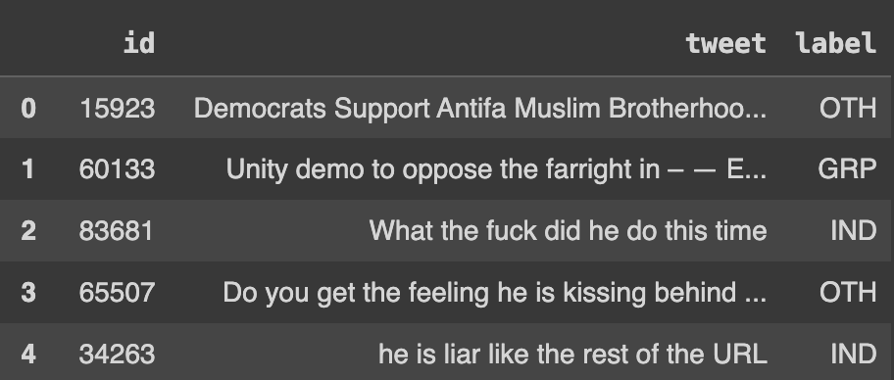
Method - Subtask C - Continued..
Split the vectors into train and test sets
Created dataframe and merged the datasets by id
Counted the labels
Applied the SVM model
Validation set
Accuracy
Classification Report
Confusion Matrix
Sampling
Word Cloud
Notes:
Sneha

Slide 28
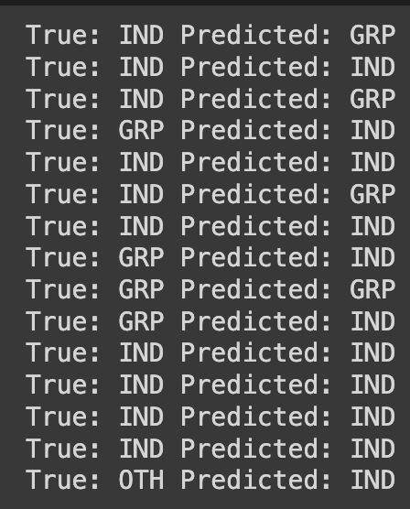
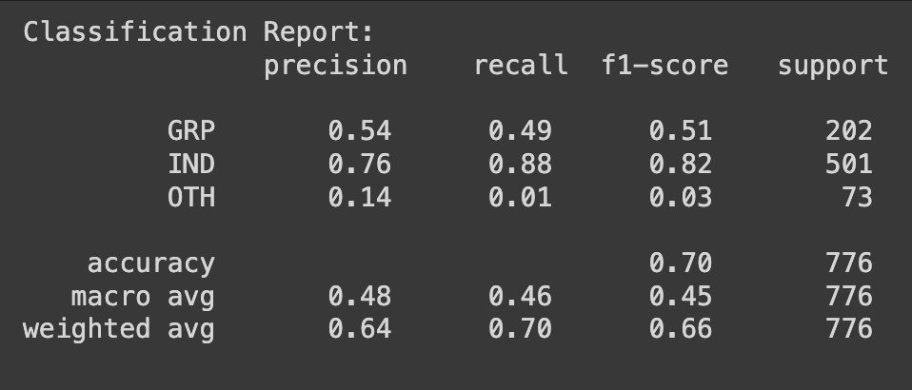
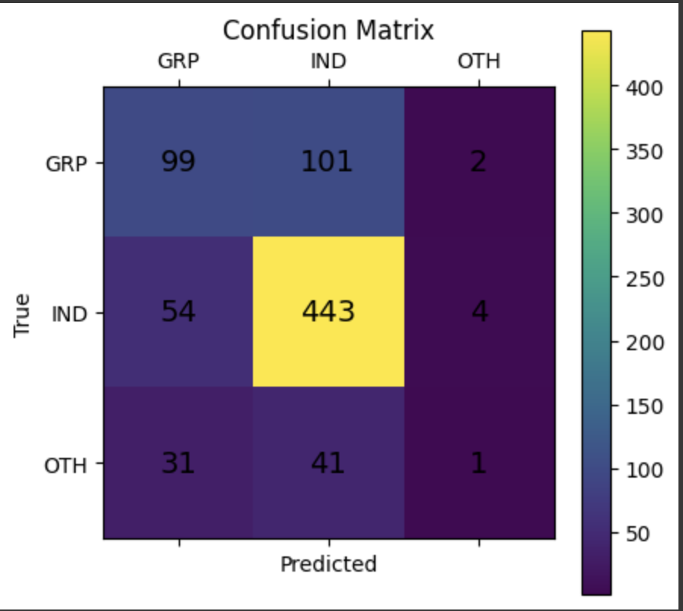
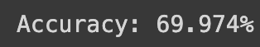
Results - Subtask C - OLID
Sampling Predictions
Notes:
Phani

Slide 29
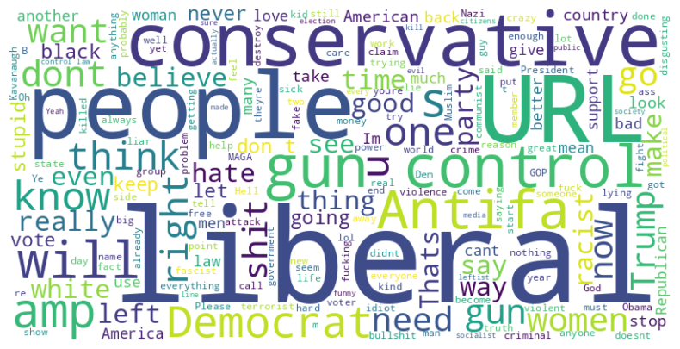
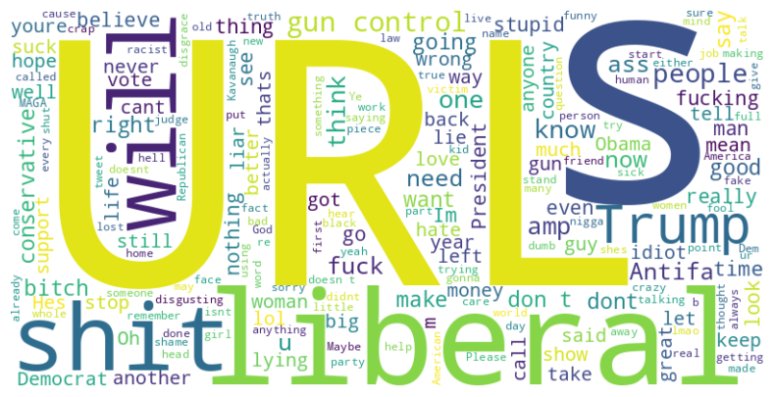
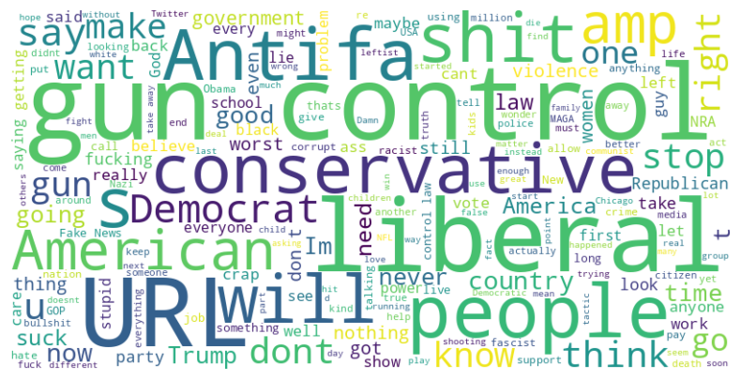
Results - Subtask C - OLID Word Cloud
GRP
GRP
GRP
IND
OTH
Notes:
Phani

Slide 30



Results - Subtask C - SOLID
Sampling Predictions
Notes:
Phani

Slide 31

Results - Subtask C - SOLID Word Cloud
Test Data Level C
Notes:
Phani

Slide 32
Conclusion
In conclusion, the OffensEval 2020 project presents a significant stride towards addressing the pervasive issue of offensive language in social media. Through the meticulous evaluation of various models, including LSTM and BERT, we have achieved noteworthy results in identifying and categorizing offensive language across different subtasks.
The LSTM model, applied to Subtask A, demonstrated a respectable performance with a precision of 0.92 and a recall of 0.99 on the SOLID 2020 extended easy test set. This indicates the model's effectiveness in accurately pinpointing offensive language, especially in less challenging instances.
The BERT model, applied to Subtask B, exhibited a commendable precision of 0.87 and a recall of 0.88 on OLID data. This suggests its robustness in categorizing offensive language, providing a solid foundation for further improvements.
However, it is essential to note that there is room for refinement, particularly in handling more complex instances of offensive language. The BERT model's performance on SOLID data indicates a lower precision of 0.83 and recall of 0.50, suggesting potential challenges in handling diverse and nuanced offensive content.
Notes:
Phani

Slide 33
Future Works
Fine-Tuning Models: Explore further fine-tuning of existing models, such as BERT, to enhance performance on specific nuances of offensive language across different cultures and contexts. This can involve additional training on domain-specific datasets to improve the model's understanding of context-dependent offensive language.
User Feedback Integration: Develop a mechanism to integrate user feedback into the model's training process. This can help in refining the model based on real-world user interactions and continuously improve its accuracy and efficiency.
Cross-Platform Integration: Extend the model's application to various social media platforms and communication channels. This involves adapting the model to different data formats and structures present in platforms beyond Twitter, making it a more comprehensive tool for content moderation.
Ensemble Approaches: Investigate ensemble methods by combining predictions from multiple models or model architectures. This can enhance the overall performance by leveraging the strengths of different models and mitigating individual weaknesses.
Notes:
Phani

Slide 34
Reference
Marcos Zampieri, Preslav Nakov, Sara Rosenthal, Pepa Atanasova, Georgi Karadzhov, Hamdy Mubarak, Leon Derczynski, Zeses Pitenis, and Çağrı Çöltekin. 2020. SemEval-2020 Task 12: Multilingual Offensive Language Identification in Social Media (OffensEval 2020). In Proceedings of the Fourteenth Workshop on Semantic Evaluation, pages 1425–1447, Barcelona (online). International Committee for Computational Linguistics.
Marcos Zampieri, Shervin Malmasi, Preslav Nakov, Sara Rosenthal, Noura Farra, and Ritesh Kumar. 2019b. SemEval-2019 Task 6: Identifying and categorizing offensive language in social media (OffensEval). In Pro- ceedings of the 13th International Workshop on Semantic Evaluation (SemEval).
Zampieri, M., Malmasi, S., Nakov, P., Rosenthal, S., Farra, N. and Kumar, R. (2019) Predicting the Type and Target of Offensive Posts in Social Media. In Proceedings of the 2019 Conference of the North American Chapter of the Association for Computational Linguistics: Human Language Technologies, Volume 1 (Long and Short Papers). pp. 1415-1420.
M. Zampieri, “SemEval-2020 Task 12: Multilingual Offensive Language Identification in Social Media (OffensEval 2020)”. Zenodo, Jul. 17, 2020. doi: 10.5281/zenodo.3950379.
https://github.com/senanindya/Offensive-Language-Identification-System
https://github.com/batuhanguler
https://github.com/aflah02/Combating_Hate_Scalably

Slide 35



Does anyone have any questions? Team 5
Picture from: https://www.forbes.com/sites/bernardmarr/2019/06/03/5-amazing-examples-of-natural-language-processing

